Slide 1

Testing Times – How to decide when to take an econometric result serious

Slide 2

Objective for today
Understand the reliability of a regression result…
…assuming there is no bias or mis-specification of the model
We are talking about the known unknowns today

Slide 3

How do you know if a Dice is fair?

Slide 4

→ Hypothesis testing for dice in a nutshell H0: Dice is fair H1: Dice is not fair If given the hypothesis something unlikely happens we reject the hypothesis
We can never 100% certain if a dice is fair
However, if something happens that is very unlikely for a fair dice (e.g. 20 sixes in a row) we will conclude the dice is rigged.

Slide 5


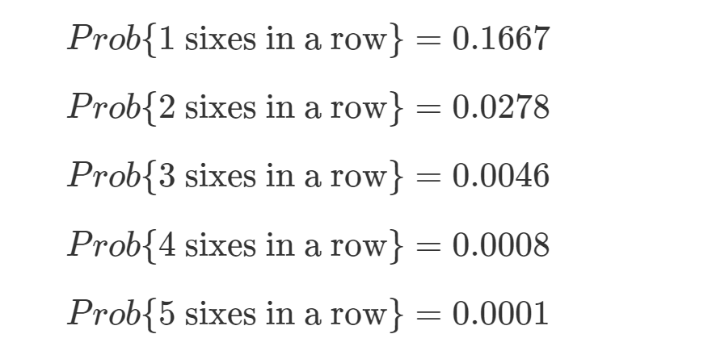

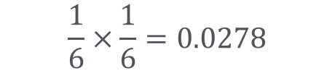
How likely is unlikely?
$$\frac{1}{6}×\frac{1}{6}=0.0278$$
Type I Error
What is unlikely is a choice….
One consideration: What are you going to do when rejecting a hypothesis
And what happens if you are wrong (i.e. the hypothesis was correct after all)
e.g. accuse somebody of being cheat?
If that person is somebody important you might want to reject only for a smaller probability

Slide 6
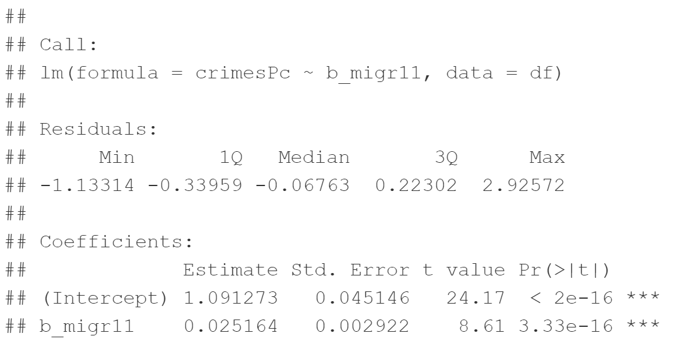

Hypothesis testing in for econometric models
$$\hat{Y}={\hat{β}}_{0}+{\hat{β}}_{1}X$$
How likely is it to see a slope such as this…
even if there is no relationship between foreigners and crime
and there is no endogeneity

Slide 7

The distribution of our estimates
To work out how likely a particular estimation outcome is given a hypothesis we need to know the distribution of the estimates
For a distribution we need the notion of a random experiment (like throwing a dice)
In the context of estimating an econometric model the random experiment is taking a random sample of a population

Slide 8
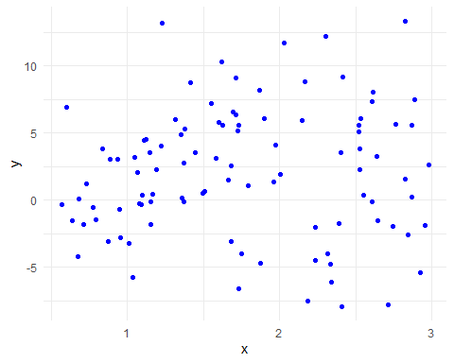
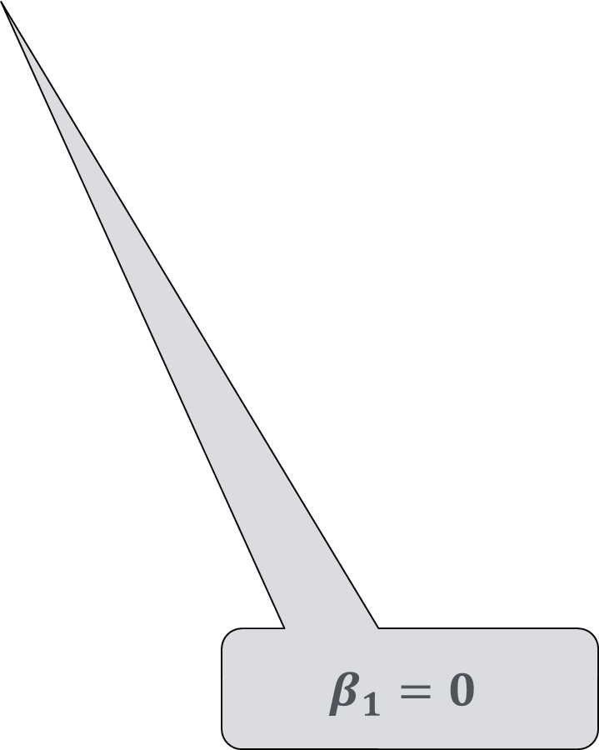
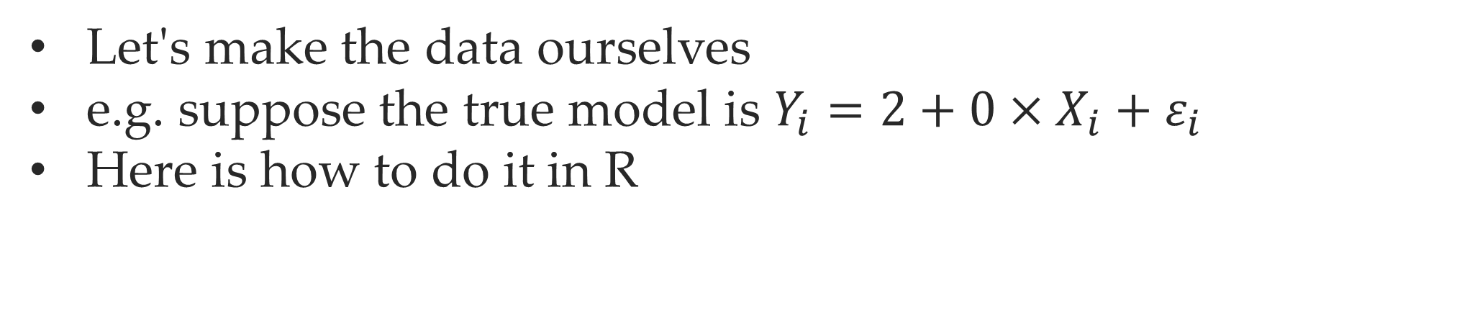
Monte Carlo Experiment
Let's make the data ourselves
e.g. suppose the true model is $Y_{i}=2+0×X_{i}+ε_{i}$
Here is how to do it in R
obs <- 100 x <- 0.5 + runif(obs)*2.5 sig=sqrt(5.5)*2 eps <- rnorm(obs,0,sig) y <- 2 + x * 0 + eps df=data.frame(x,y) ggplot(df, aes(x, y))+geom_point(color="blue") +theme_minimal()
$$β_{1}=0$$

Slide 9
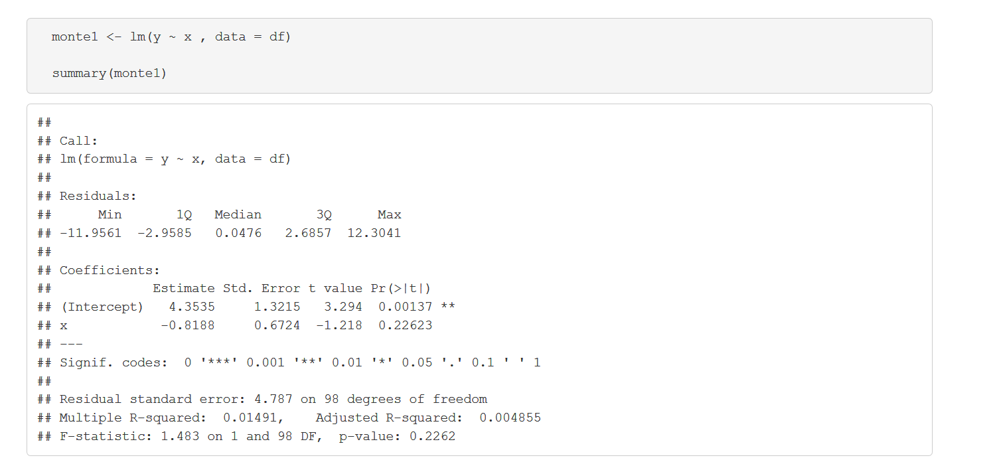
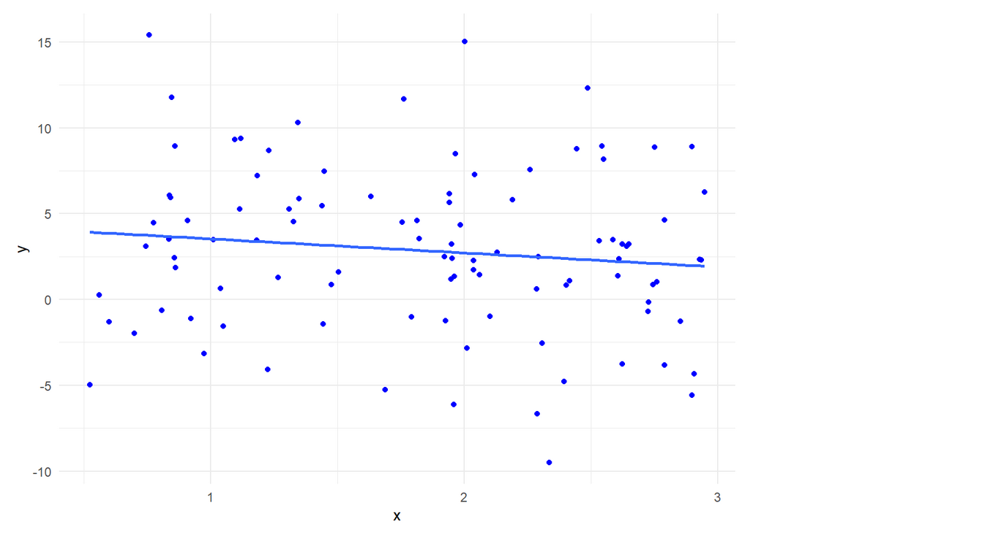

Let’s run regression
How does it compare?
$$Y_{i}=2+0×X_{i}+ε_{i}$$

Slide 10
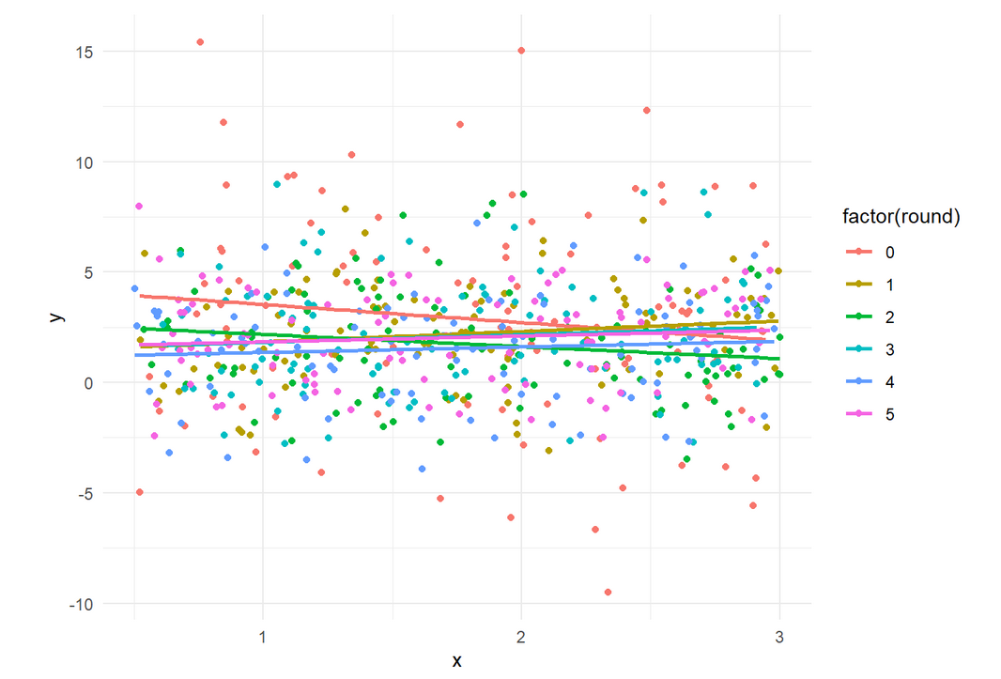
Let’s do it many times
Each time we get a slightly different line

Slide 11
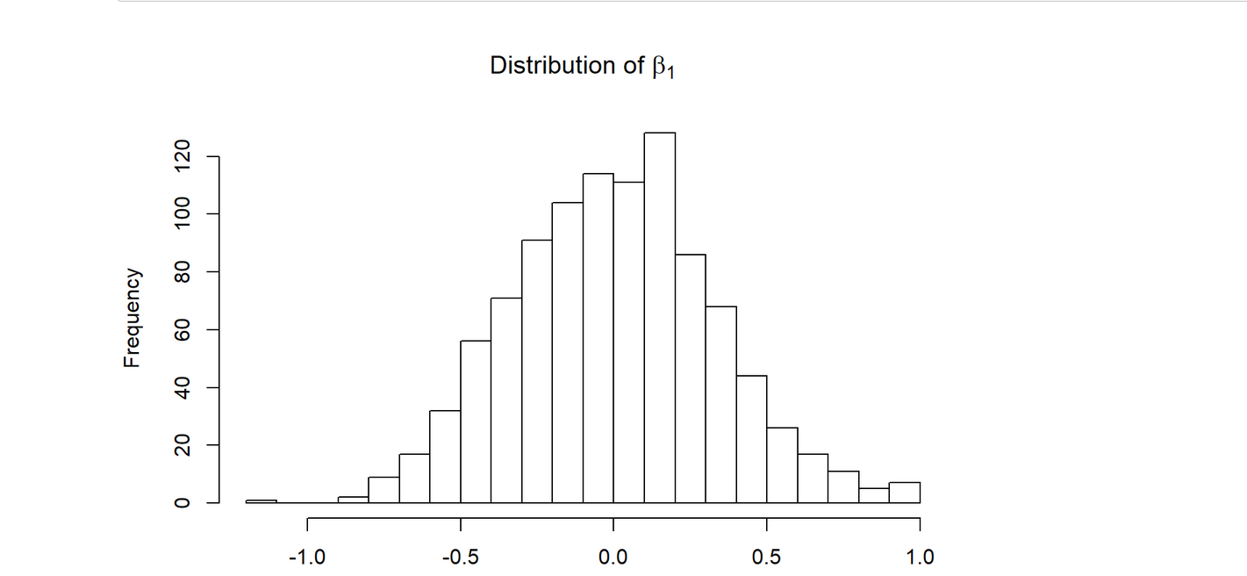
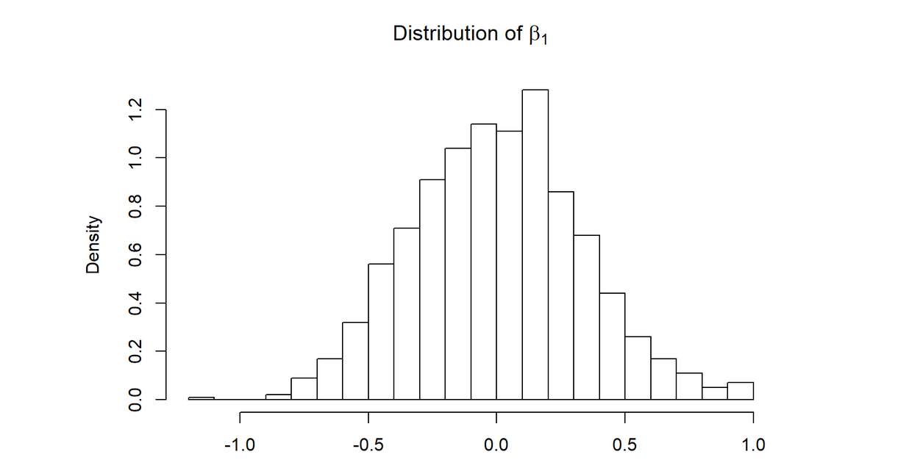
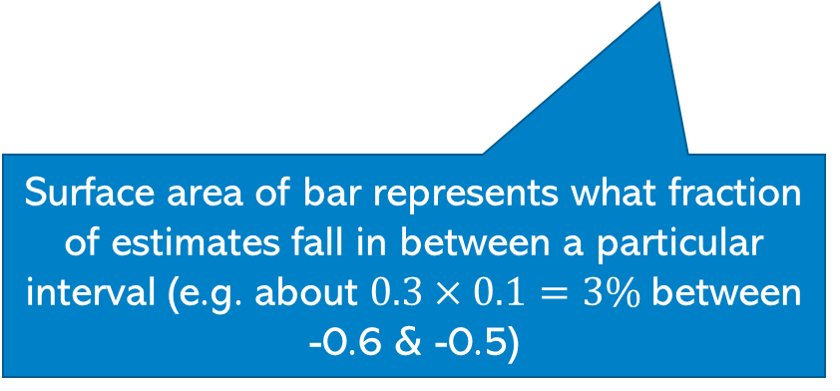

Let’s look at histogram of $β_{1}$ for 1000 replications of drawing a sample
How many cases fall in a particular interval (e.g. about 30 between -0.6 & -0.5)
Share falling into bin over bin-width
-0.6
What is the probability of that we get a value between 0.5 and 1?
Sum up the area of all bars
Surface area of bar represents what fraction of estimates fall in between a particular interval (e.g. about $0.3×0.1=3\%$between -0.6 & -0.5)

Slide 12
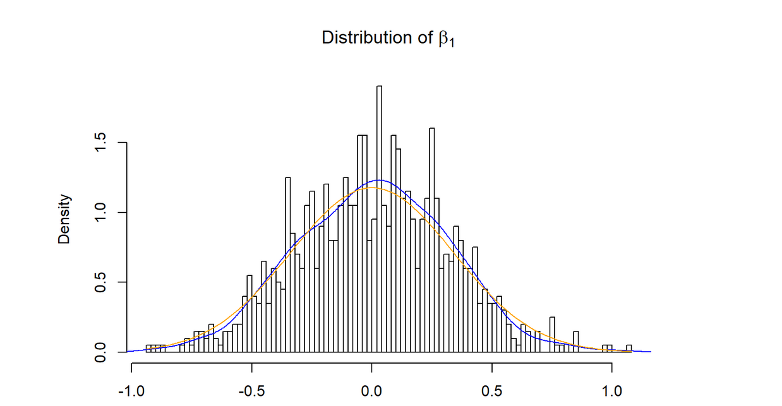

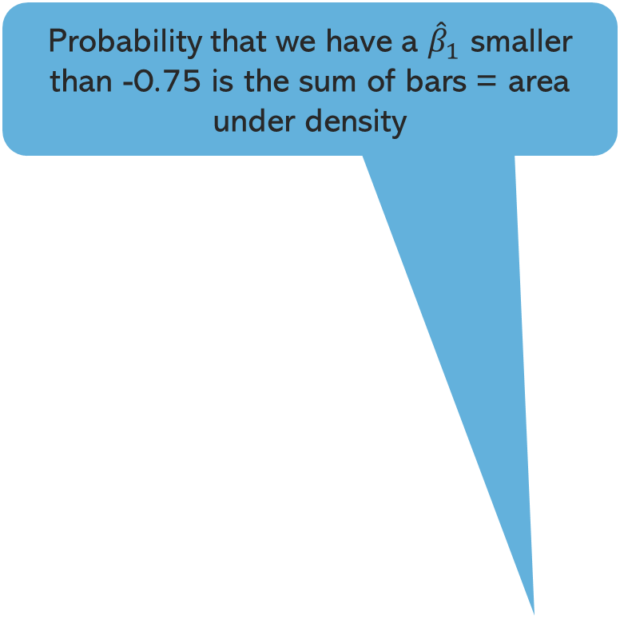
A density plot: making bins narrower
Distribution is very close to a normal distribution
Probability that we have a ${\hat{β}}_{1}$ smaller than -0.75 is the sum of bars = area under density
Distribution of ${\hat{β}}_{1}$

Slide 13
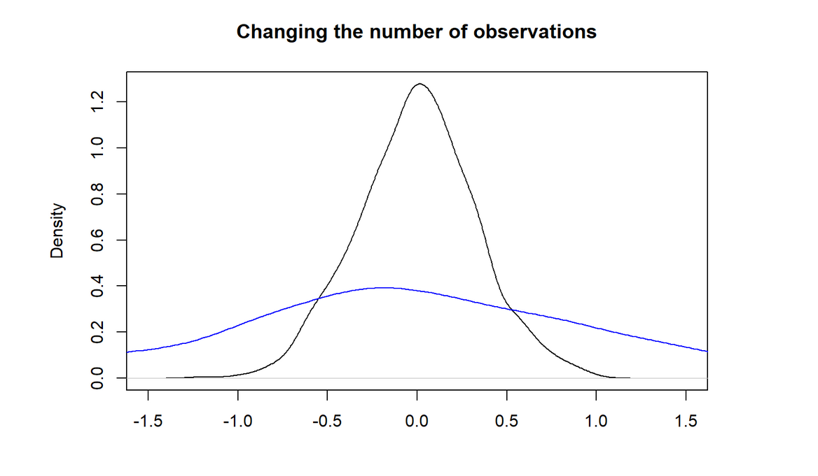
Large vs small sample
The distribution is more dispersed for a sample of 10 (small sample) than for a sample of 100
10 observations

Slide 14
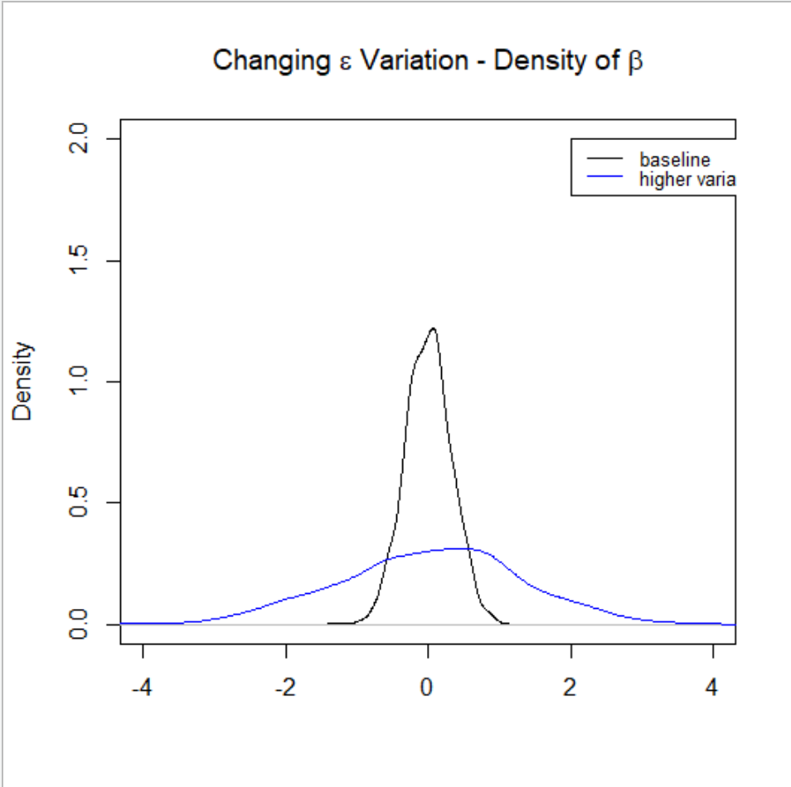
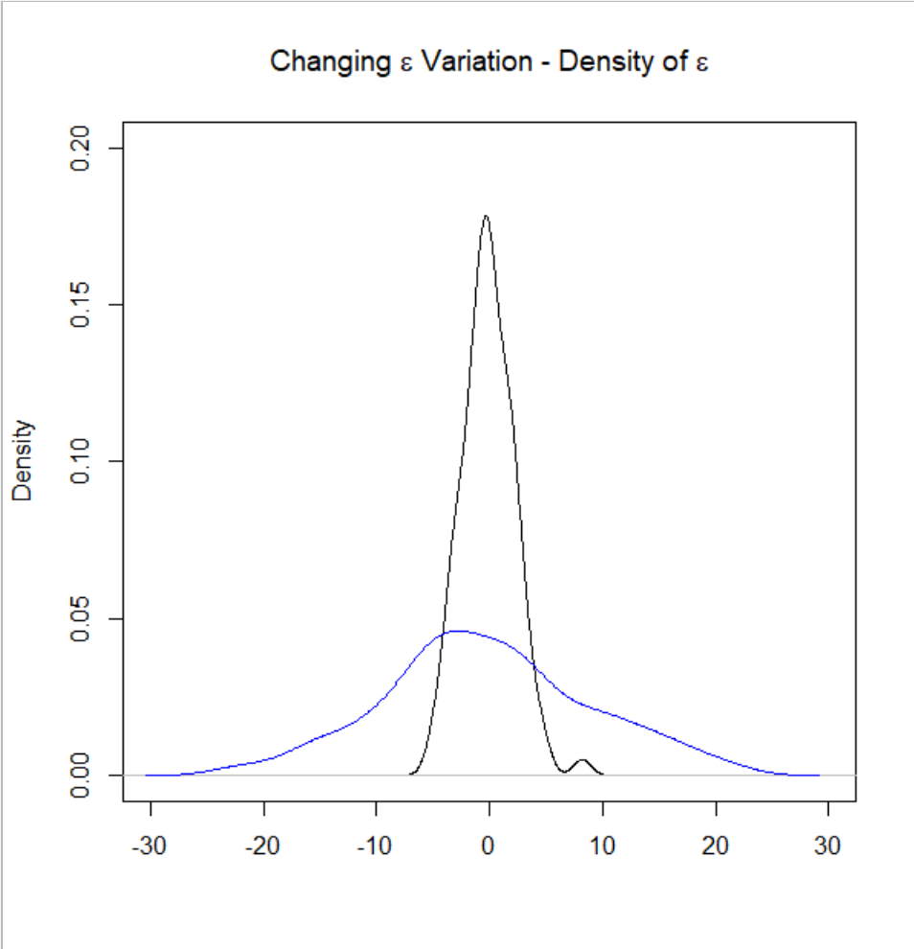

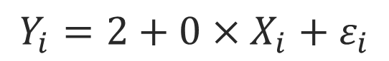
More variation in $ε$
$$Y_{i}=2+0×X_{i}+ε_{i}$$
There is a lot more we don’t know about Y
eps_more_var_eps = rnorm(obs,0,sig*4)

Slide 15
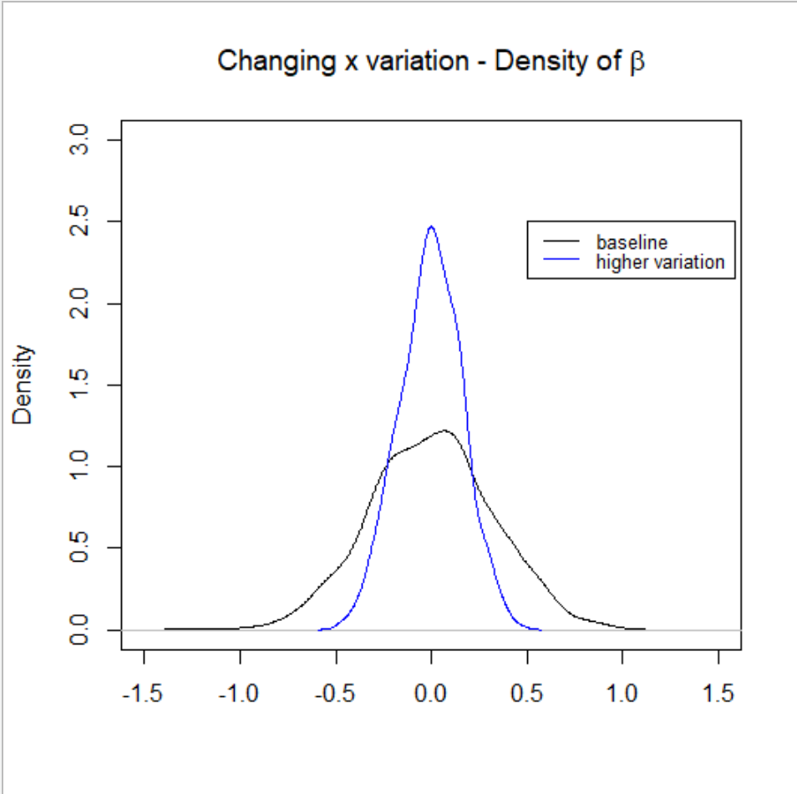
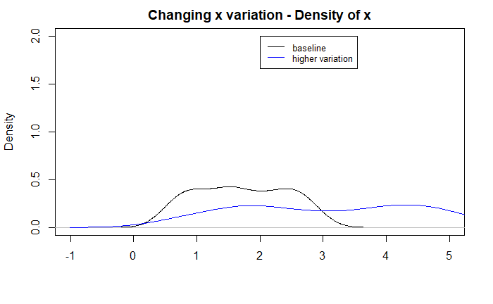

Dispersed X vs not so dispersed X
If X varies more our estimate of $β$ becomes more precise

Slide 16
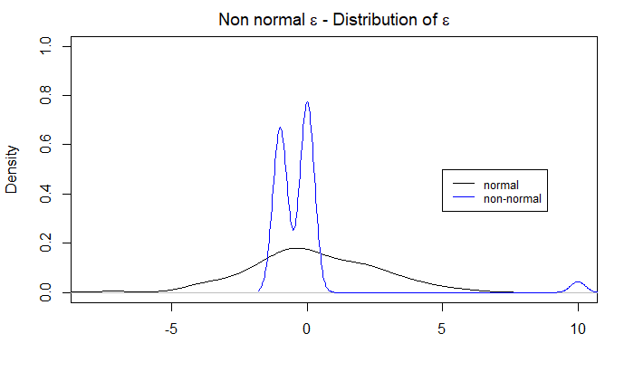
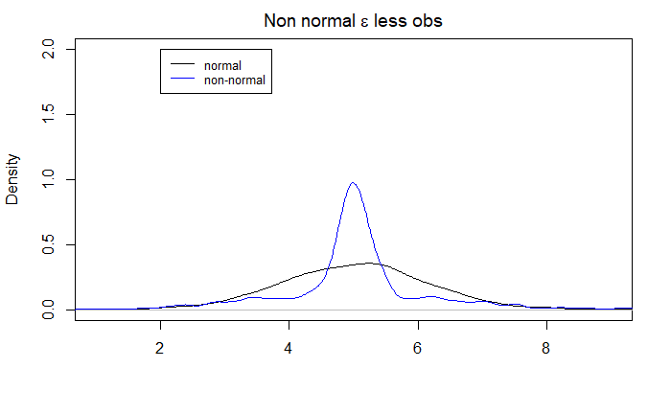
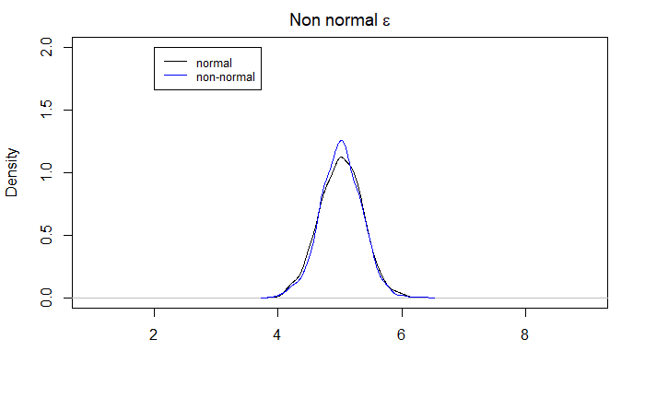


Non normal $ε$
Non normal $ε$ with same variance
Normal $ε$
Small sample (10 obs)
Large sample (100 obs)
Central limit theorem
Notes:
E

Slide 17
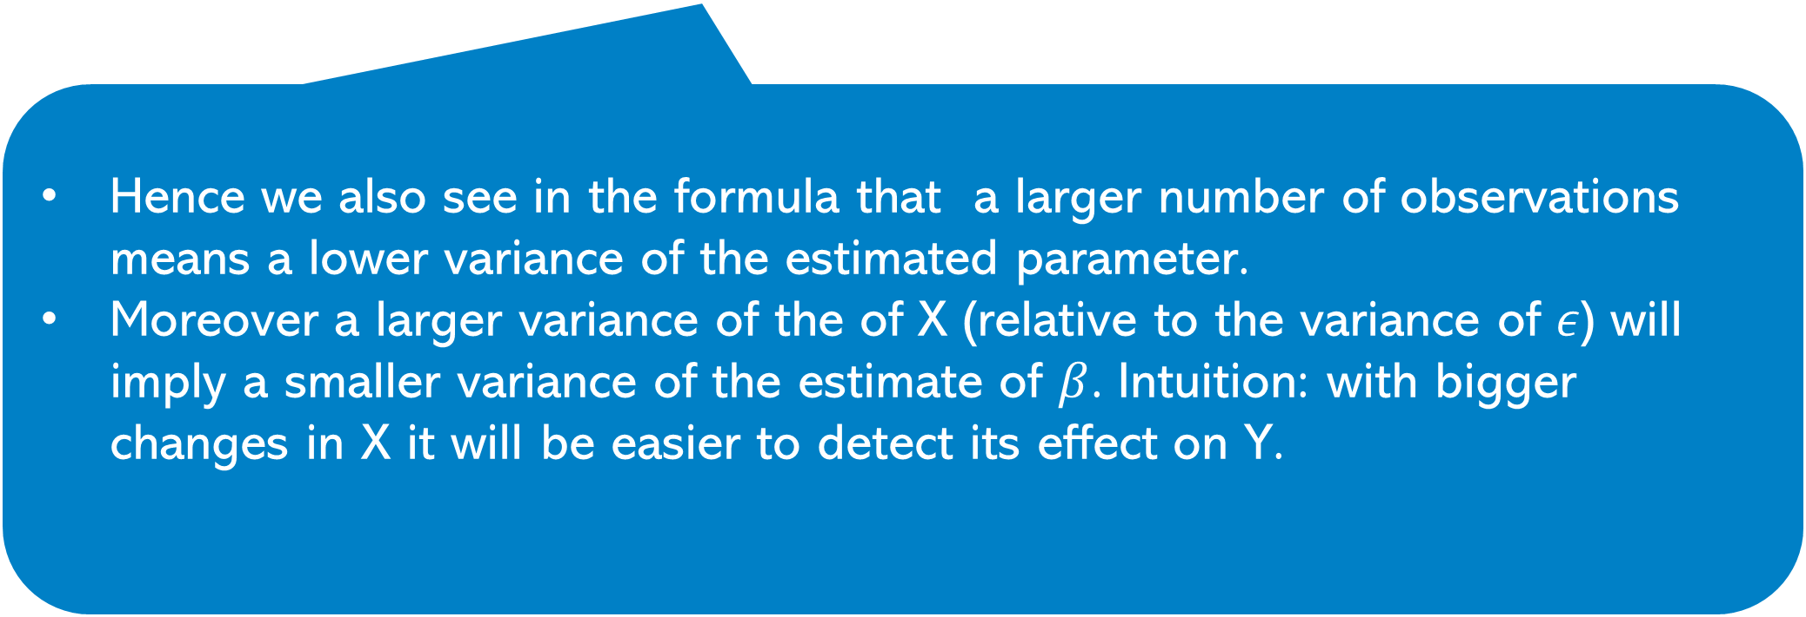
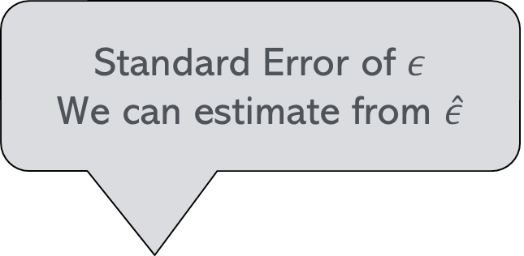
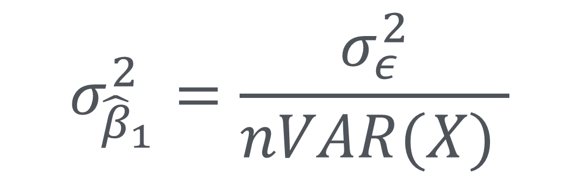
The variance of the estimator
Standard Error of $ε$
We can estimate from $\hat{ε}$
$$σ_{{\hat{β}}_{1}}^{2}=\frac{σ_{ε}^{2}}{nVAR(X) }$$
Standard Error of estimate
Hence we also see in the formula that a larger number of observations means a lower variance of the estimated parameter.
Moreover a larger variance of the of X (relative to the variance of $ε$) will imply a smaller variance of the estimate of $β$. Intuition: with bigger changes in X it will be easier to detect its effect on Y.

Slide 18
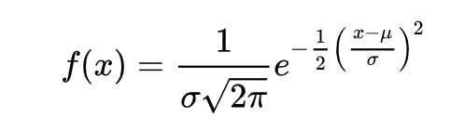
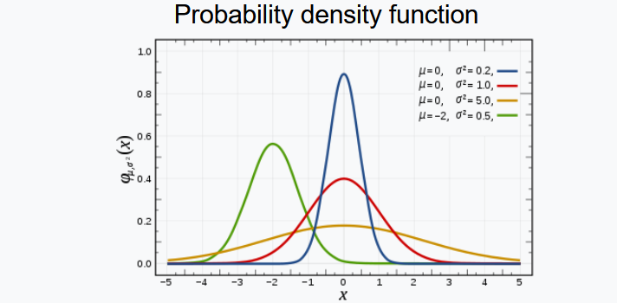
Recap
Regression estimates are (approximately) normally distributed
We can work out the variance
Normal distribution is fully characterized by standard error and mean
To work out the likelihood of that a value of a particular value arises we can work out the area under the density
We can define how much risk of being wrong we are willing to accept and then work out a critical threshold
Significance level

Slide 19
The foreigners cause crime hypothesis
P value: Probability that we have values more extreme than what we estimated
df=ff reg1=lm(crimesPc~b_migr11,df) reg1 %>% summary()
## ## Call: ## lm(formula = crimesPc ~ b_migr11, data = df) ## ## Residuals: ## Min 1Q Median 3Q Max ## -1.13314 -0.33959 -0.06763 0.22302 2.92572 ## ## Coefficients: ## Estimate Std. Error t value Pr(>|t|) ## (Intercept) 1.091273 0.045146 24.17 < 2e-16 *** ## b_migr11 0.025164 0.002922 8.61 3.33e-16 ***

Slide 20

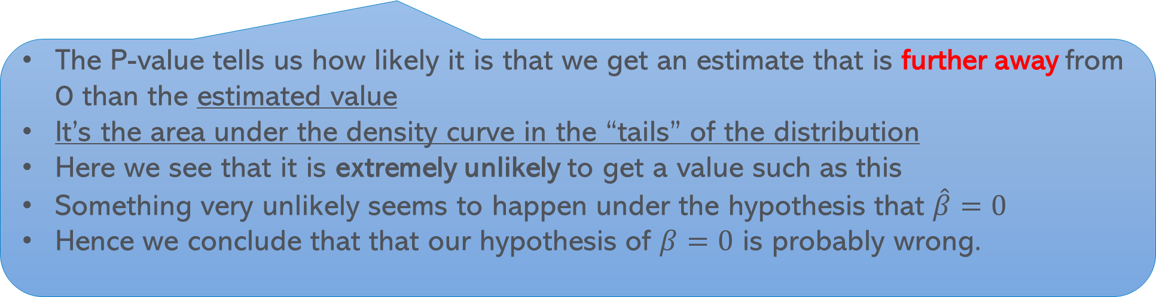


P-value
## Call: ## lm(formula = crimesPc ~ b_migr11, data = df) ## ## Residuals: ## Min 1Q Median 3Q Max ## -1.13314 -0.33959 -0.06763 0.22302 2.92572 ## ## Coefficients: ## Estimate Std. Error t value Pr(>|t|) ## (Intercept) 1.091273 0.045146 24.17 < 2e-16 *** ## b_migr11 0.025164 0.002922 8.61 3.33e-16 ***
$$0$$
$$\hat{β}$$
-0.025
0.025
The P-value tells us how likely it is that we get an estimate that is further away from 0 than the estimated value
It’s the area under the density curve in the “tails” of the distribution
Here we see that it is extremely unlikely to get a value such as this
Something very unlikely seems to happen under the hypothesis that $\hat{β}=0$
Hence we conclude that that our hypothesis of $β=0$ is probably wrong.

Slide 21
Significance levels – How likely is unlikely?
We reject the hypothesis if the estimate is unlikely given the hypothesis
But what kind of likelihood should you apply?
Depends a bit on the stakes
Type I error: What happens if I am wrong (i.e. the hypothesis was correct after all)
We want the risk of such error to be small. But how small depends on circumstance and preferences.
Typical values: 1%, 5%, 10%
We reject a hypothesis only if the event happening is smaller than 1%, 5% or 10%

Slide 22




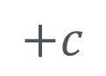
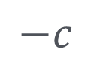

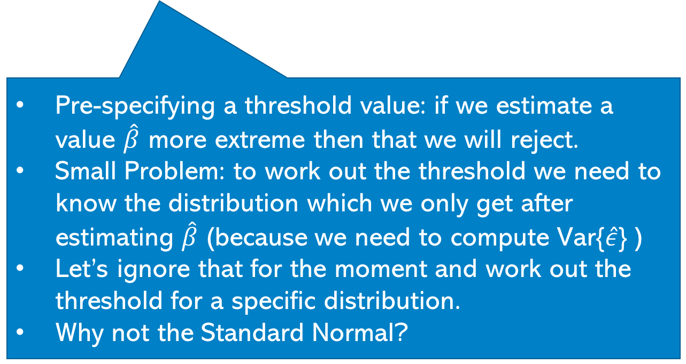
Critical values
Define how much risk of being wrong we are willing to accept and work out a critical threshold value for $\hat{β}$ (call it c)
If we find $\hat{β}$>c or $\hat{β}<−$c we know to reject that it is 0.
Reject hypothesis
Accept hypothesis
Reject hypothesis
$$−c$$
$$0$$
$$+c$$
$$\hat{β}$$
Null Hypothesis H0: $β=0$
Alternative Hypothesis H1: $β≠0$
Pre-specifying a threshold value: if we estimate a value $\hat{β}$ more extreme then that we will reject.
Small Problem: to work out the threshold we need to know the distribution which we only get after estimating $\hat{β}$ (because we need to compute Var{$\hat{ε}$} )
Let’s ignore that for the moment and work out the threshold for a specific distribution.
Why not the Standard Normal?

Slide 23
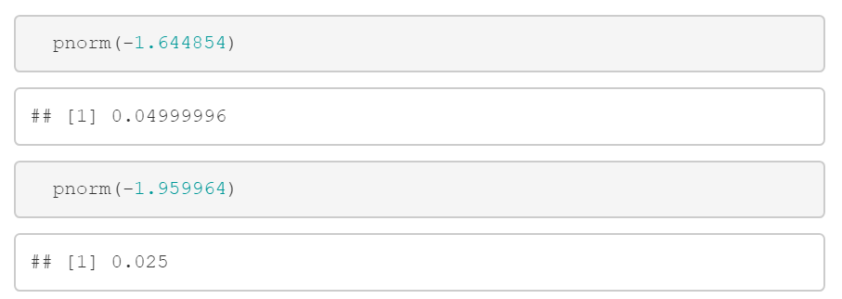



Finding c: Standard Normal ($σ=1)$
=10%
=5%
$$0$$
$$\hat{β}$$
-1.96
-1.64
1.64
1.96
Say we willing to accept a higher risk
Would we have a lower or higher threshold than c=1.96?
E.g. what about 10% Type I risk?
Threshold for 1%? 2.576

Slide 24
Finding c: Standard Normal ($σ=1)$
=10%
=5%
$$0$$
$$\hat{β}$$
-1.96
-1.64
1.64
1.96
Say we willing to accept a higher risk
Would we have a lower or higher threshold than c=1.96?
E.g. what about 10% Type I risk?

Slide 25
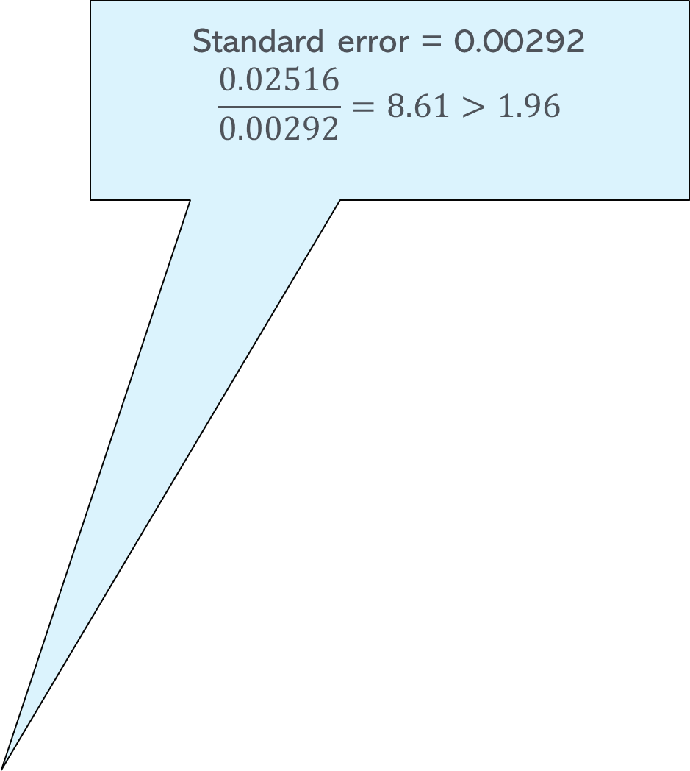

The foreigners cause crime hypothesis
Standard error = 0.00292
$$\frac{0.02516}{0.00292}=8.61>1.96$$
df=ff reg1=lm(crimesPc~b_migr11,df) reg1 %>% summary()
## ## Call: ## lm(formula = crimesPc ~ b_migr11, data = df) ## ## Residuals: ## Min 1Q Median 3Q Max ## -1.13314 -0.33959 -0.06763 0.22302 2.92572 ## ## Coefficients: ## Estimate Std. Error t value Pr(>|t|) ## (Intercept) 1.091273 0.045146 24.17 < 2e-16 *** ## b_migr11 0.025164 0.002922 8.61 3.33e-16 ***
$$σ_{{\hat{β}}_{1}}^{2}=\frac{σ_{\hat{ε}}^{2}}{nVAR(X) }$$
t-value = Coefficient Estimate/Standard Error

Slide 26
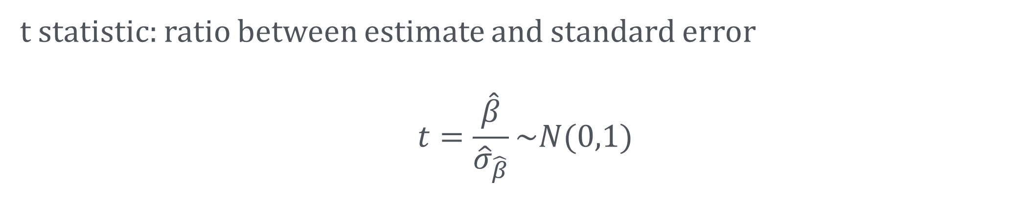
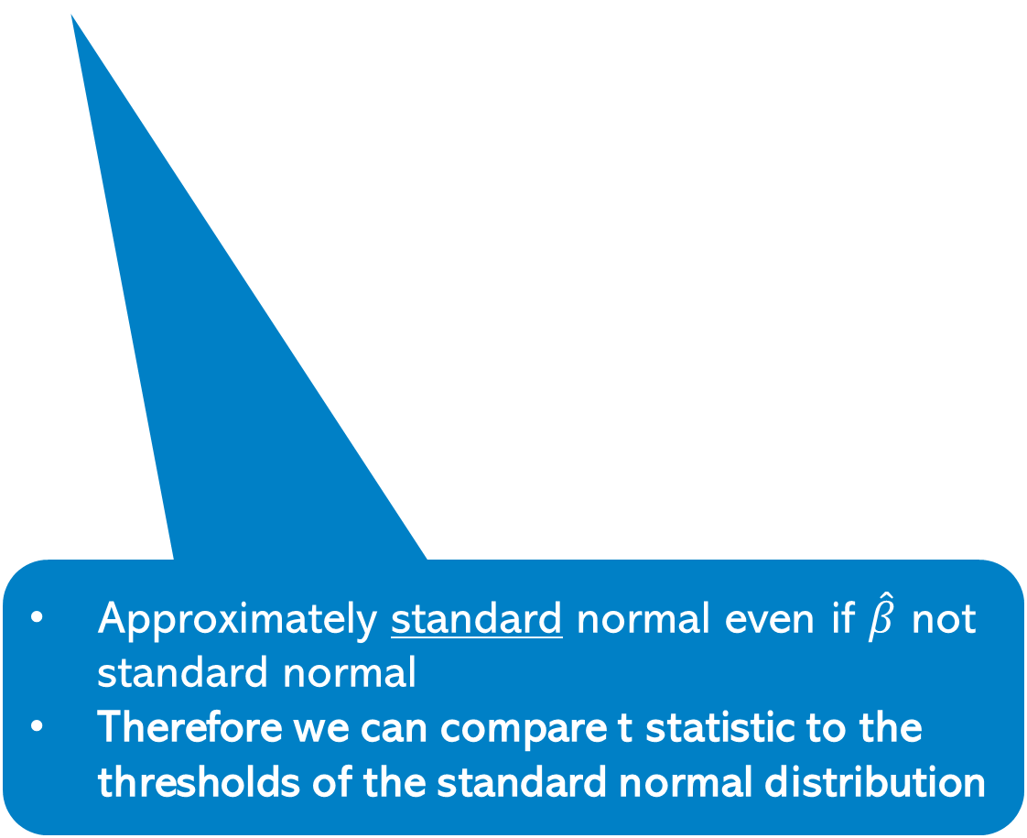
t statistic: ratio between estimate and standard error
$$t=\frac{\hat{β}}{{\hat{σ}}_{\hat{β}}}\sim N(0,1)$$
Approximately standard normal even if $\hat{β}$ not standard normal
Therefore we can compare t statistic to the thresholds of the standard normal distribution

Slide 27
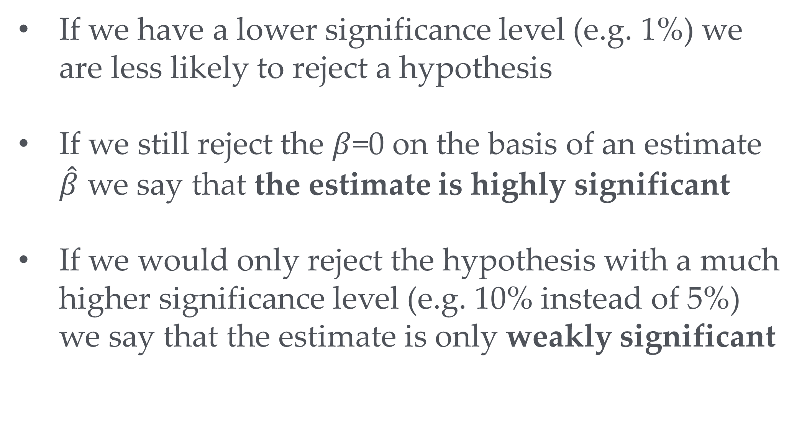
More or less significant estimates
If we have a lower significance level (e.g. 1%) we are less likely to reject a hypothesis
If we still reject the $β$=0 on the basis of an estimate $\hat{β}$ we say that the estimate is highly significant
If we would only reject the hypothesis with a much higher significance level (e.g. 10% instead of 5%) we say that the estimate is only weakly significant

Slide 28
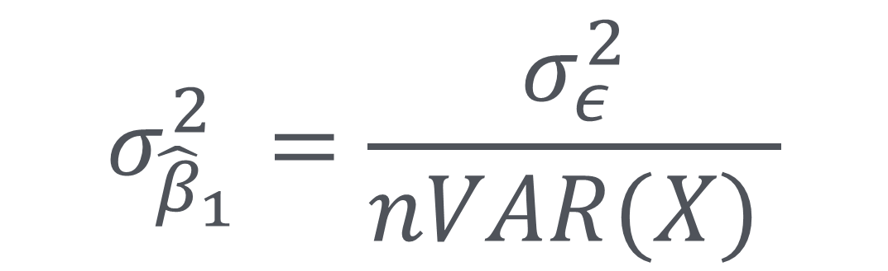
Distribution of $\hat{β}$
We infer what might happen if repeatedly obtain data samples
$$σ_{{\hat{β}}_{1}}^{2}=\frac{σ_{ε}^{2}}{nVAR(X) }$$

Slide 29
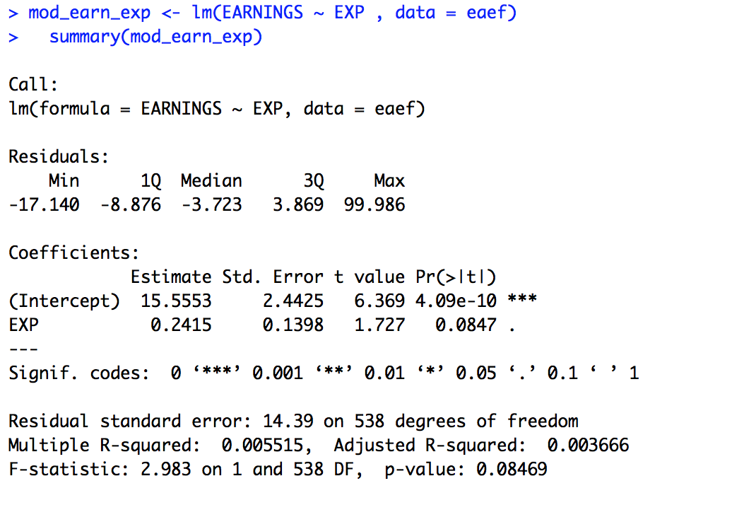
Another example
eaef <- read.csv("https://www.dropbox.com/s/31lyn5p5edyoxl5/eaef21.csv?dl=1")
EXP= years of job experience
Your turn: What do you conclude from this regression? (multiple options can be correct)
EXP coefficient is significantly different from 0 at 1%
EXP coefficient is significantly different from 0 at 5%
EXP coefficient is significantly different from 0 at 10%

Slide 30
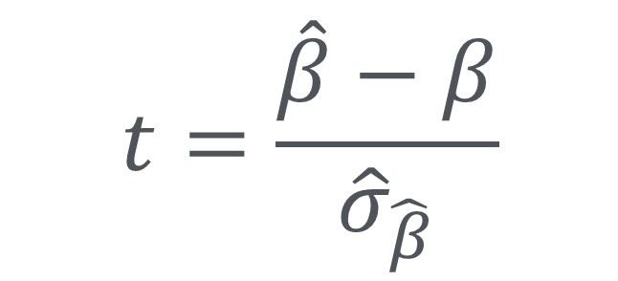
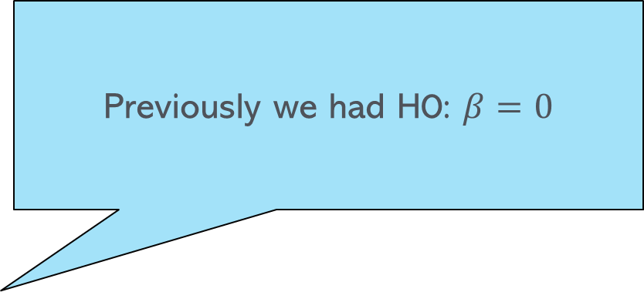
More general hypothesis tests
Previously we had H0: $β=0$
$$t=\frac{\hat{β}−β}{{\hat{σ}}_{\hat{β}}}$$
As before we can compare the t statistic with the critical values c for the standard normal distribution
Expected value of estimate under H0

Slide 31
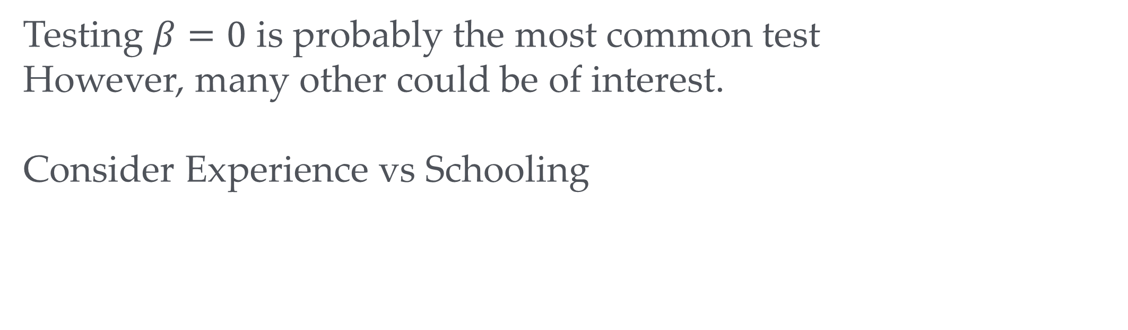
More general tests example
Testing $β=0$ is probably the most common test
However, many other could be of interest.
Consider Experience vs Schooling
Possible hypothesis: one year of schooling leads to one year less of experience
Can we reject this?
How to find out?

Slide 32
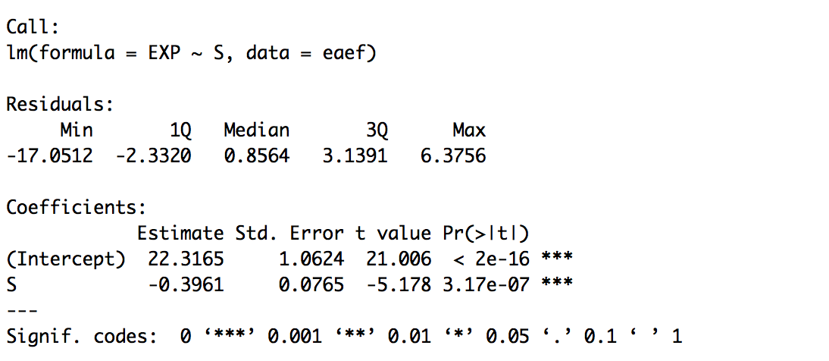
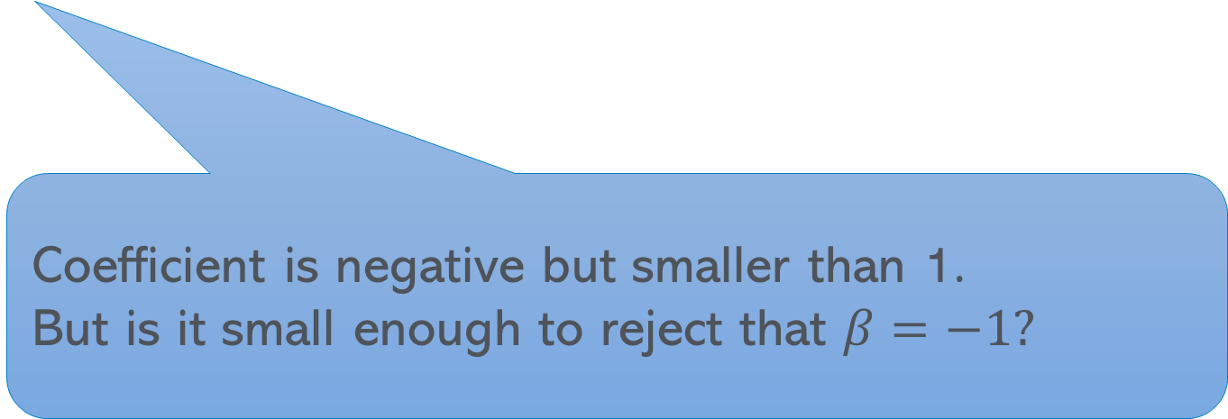
Experience vs schooling
mod_earn_exp <- lm(EXP ~ S , data = eaef)
Coefficient is negative but smaller than 1.
But is it small enough to reject that $β=−1?$

Slide 33
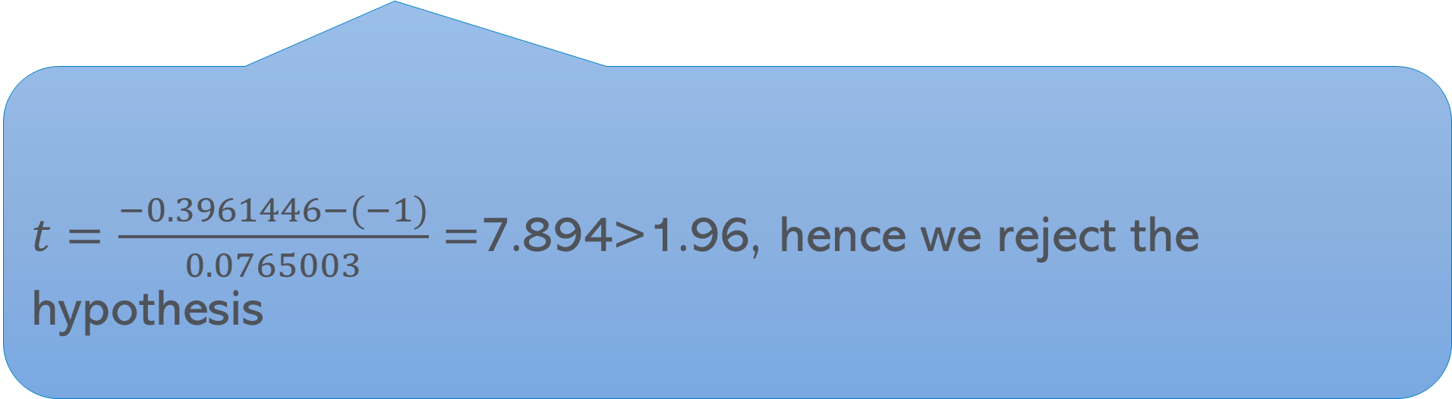
Experience vs schooling
mod_earn_exp <- lm(EXP ~ S , data = eaef)
$t=\frac{−0.3961446−(−1)}{0.0765003}=$7.894>1.96, hence we reject the hypothesis

Slide 34
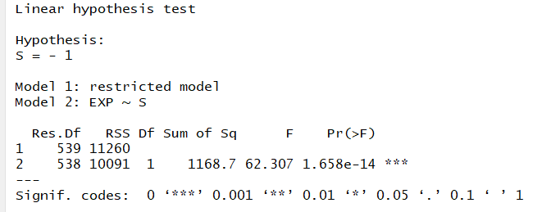
Experience vs schooling
mod_earn_exp <- lm(EXP ~ S , data = eaef)
Alternative way to implement this test in R:
library("car")
linearHypothesis(mod_earn_exp, c( "S = -1") )

Slide 35
A note of caution
An estimate can be significant and biased
Or non-significant and non-biased (or vice versa)
Significance is separate from bias
We don’t necessarily prefer one estimator over another because one is significant.
We need to ask for underlying reasons why one estimate is significant and the other one not.
Quick test: we have 2 estimates of the same parameter. Which would you prefer?
Estimate 1 is biased and significant, estimate 2 is not significant but not biased?

Slide 36

Extra Slides

Slide 37


Working out the threshold yourself
The higher the significance level the smaller the threshold
Higher significance level means we are less worried about an error of type I (reject even if true)
Hence we are happy to reject in more cases
$$\frac{1\%}{2}$$
qnorm(0.005) = -2.575829
qnorm(0.005) = -2.575829
qnorm(0.025) = -1.959964
qnorm(0.05) = -1.644854
To help with probability distributions check out this really cool probability distribution viewer (done in R)
$$\frac{10\%}{2}$$
5%
1%
Inverse of the cumulative distribution function
10%
qnorm(0.995) = 2.575829 qnorm(0.975) = 1.959964
qnorm(0.95) = 1.644854
0.05

Slide 38
Easy and hard estimation tasks – Another visual summary of the issues
Both point clouds have are driven by the same underlying model: y=10-x (green line)

Slide 39


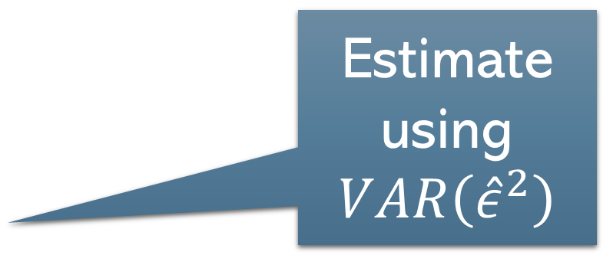
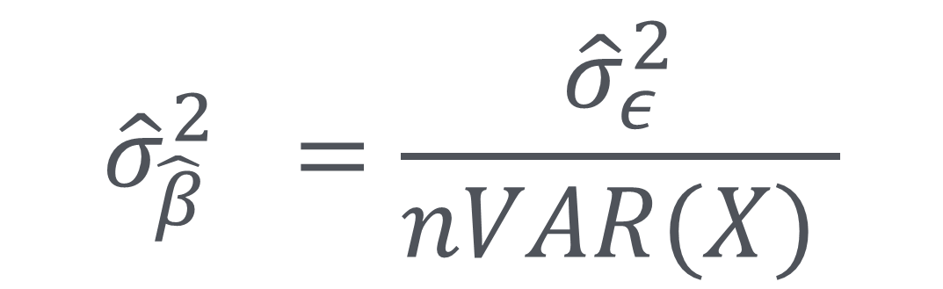
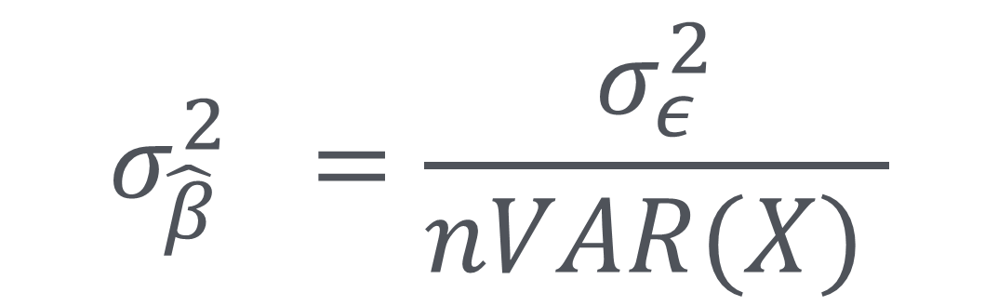
Estimation of $σ_{\hat{β}}$
VAR($\hat{ε})$
$$σ_{{\hat{β}}_{}}^{2}=\frac{σ_{ε}^{2}}{nVAR(X) }$$
Estimate using $VAR\left({\hat{ε}}^{2}\right)$
$${\hat{σ}}_{{\hat{β}}_{}}^{2}=\frac{{\hat{σ}}_{ε}^{2}}{nVAR(X) }$$

Slide 40
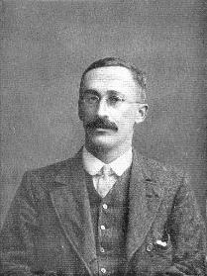

Student’s t-Distribution
Cheers!
Standard normal
William Sealy Gosset
AKA Student
t is a bit more dispersed than the normal
Converges to Normal for large n
We only need to worry about t for really small samples (<50)
Degrees of Freedom (DoF): observations – parameters we need to estimate before we can estimate $ε$

